Slide 1
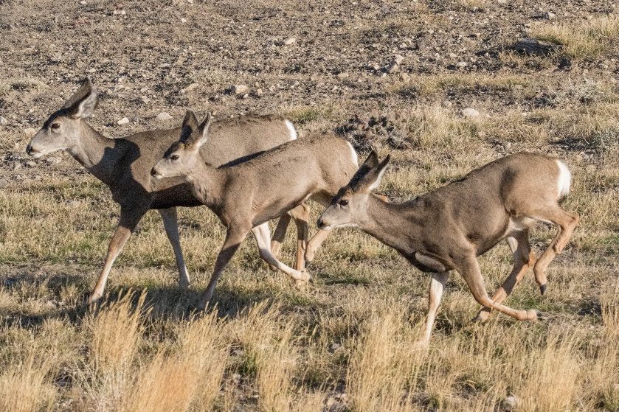
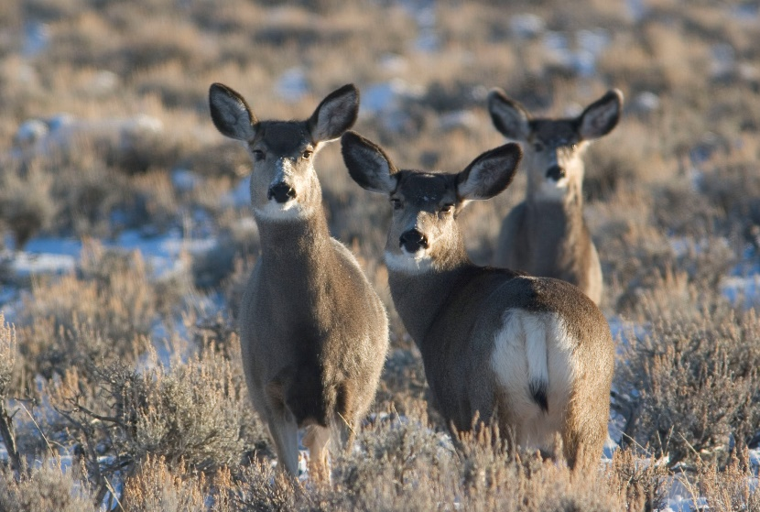
22-03: Mule deer focal herds
Embere Hall
Science, Research, and Analytical Support Unit Supervisor

Slide 2
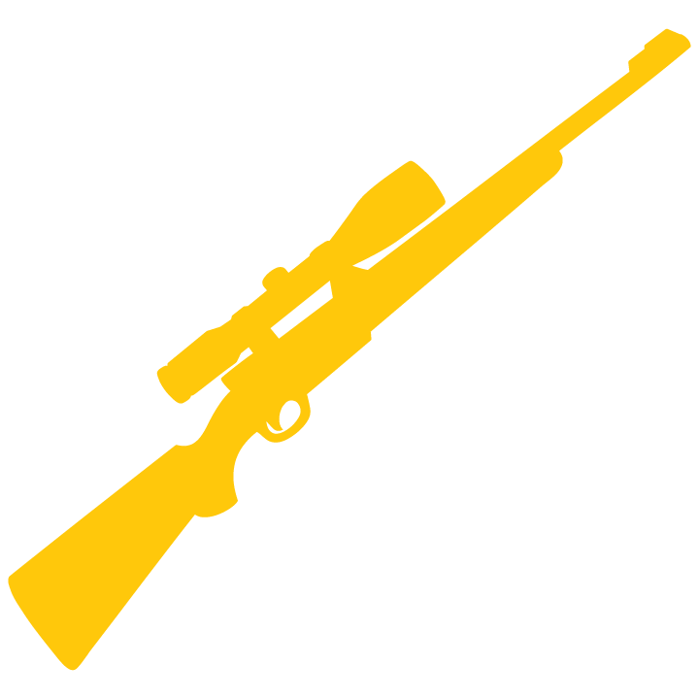
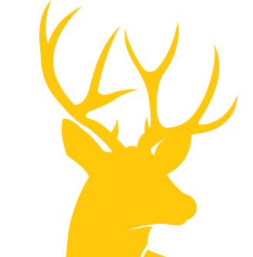
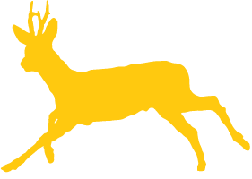
STATE-OF-THE-ART-MONITORING
6 areas critical to management
Cutting-edge information on harvest and public values
More reliable information on herd size
Robust data on herd composition
Access to data that’s accurate and immediately available
Disease and nutrition assessments
Meaningful assessments of survival, movement and habitat use

Slide 3
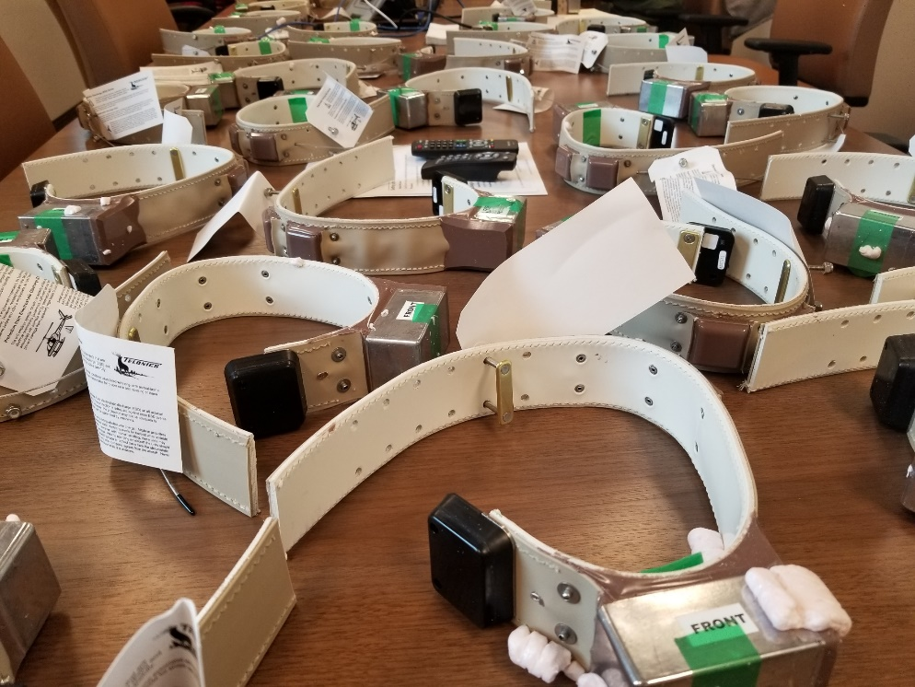
SURVIVAL
Better understand survival, including effects of different disease, habitat and predators
(this gray box is image/photo placeholder)
4x6
(this gray box is image/photo placeholder)
Learn about movement patterns, seasonal ranges, drivers of herd performance, effectiveness of habitat treatments and more

Slide 4
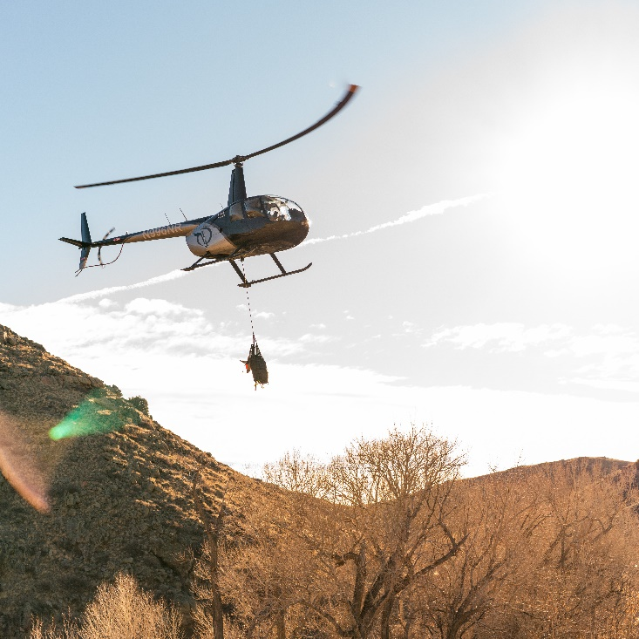
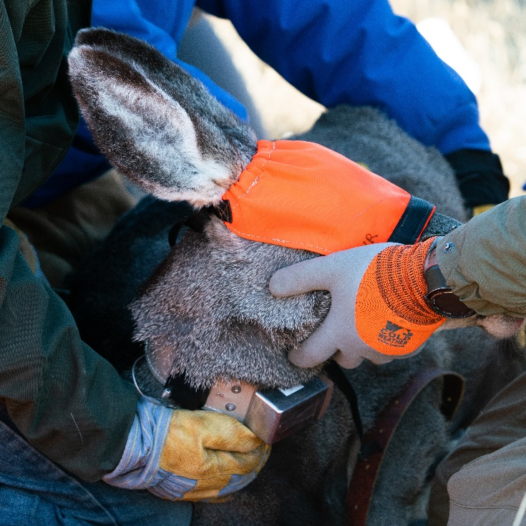
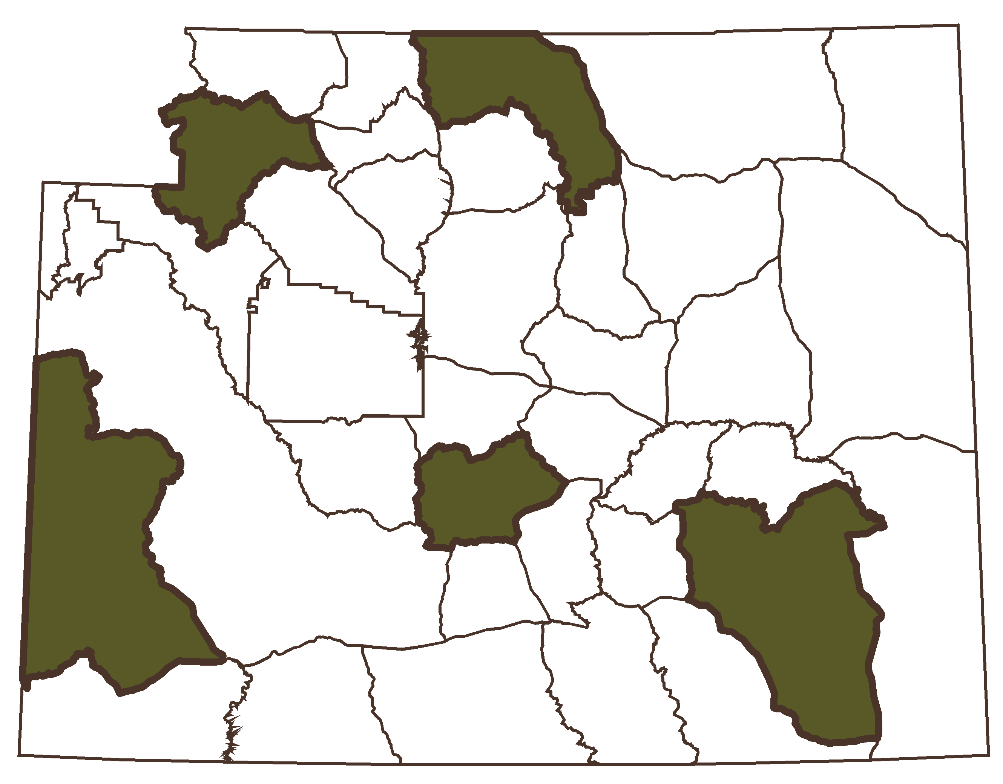
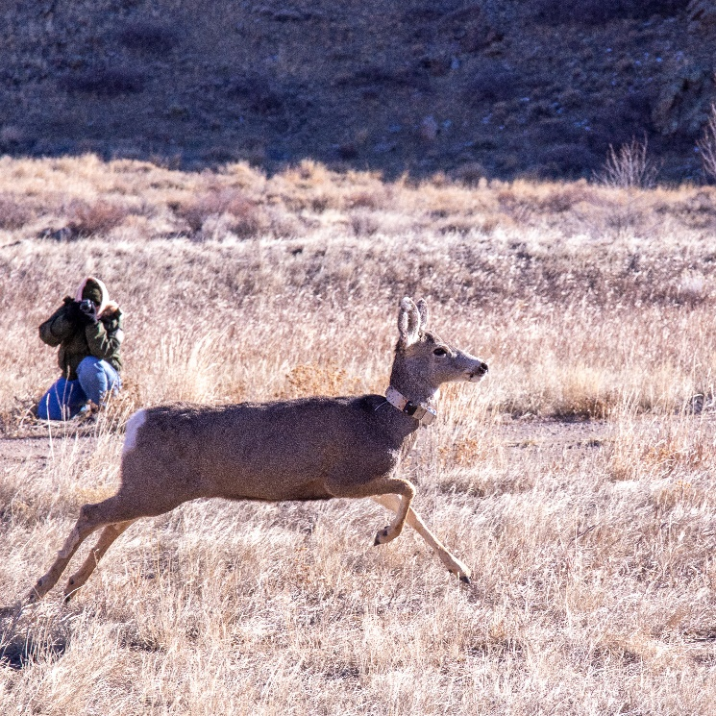
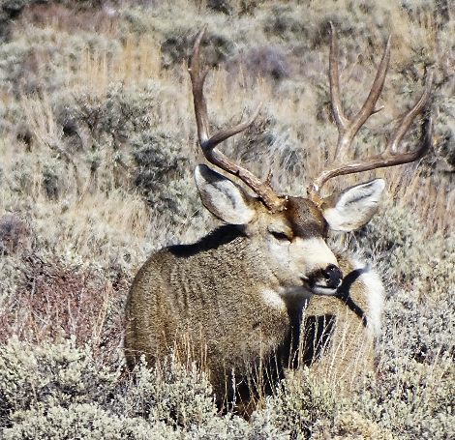
FOCAL HERDS
Launched Nov 2022
North Bighorn
Upper Shoshone
Wyoming Range
Sweetwater
Laramie Mtns.

Slide 5
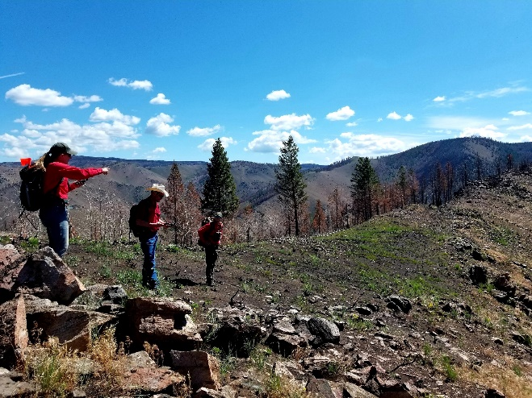
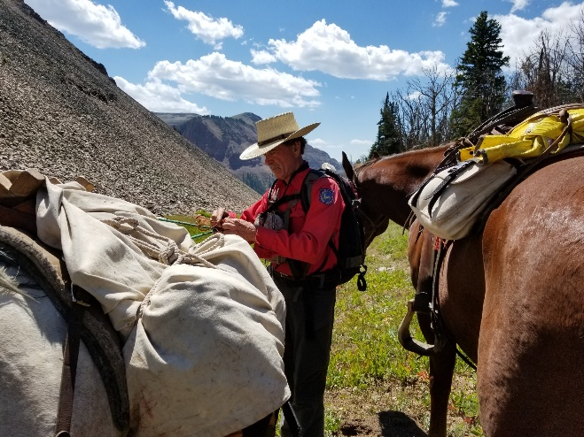
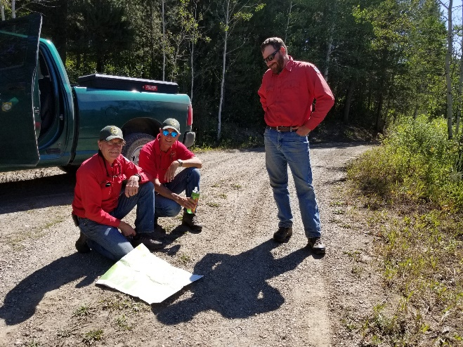
APPROACH
80 does, 30 bucks, 100 juveniles (6 month olds) marked in each herd
GPS technology
Captures Nov 2022 – Jan 2023
> 1,000 marked animals
6 direct mortalities (0.6%); 29 within 2 weeks (2.3%)
Notes:
2022 direct mortality
Laramie Mountains: 2 animals (1 buck, 1 juvenile)
Sweetwater: 2 animals (2 bucks)
Wyoming Range: 0 animals
2023 direct mortality:
North Bighorn: 1 (Doe)
Upper Shoshone: 1 (Doe), We might want to check with Tony on their darting effort because it sounded like there may have been a few?
2022 capture related mortalities (16 total):
Laramie Mountains: 9 (1 Buck, 3 Does, 5 Juvenile)
Sweetwater: 5 (5 Juvenile)
Wyoming Range: 2 (1 Buck, 1 Juvenile)
2023 capture related mortalities (13 total):
North Bighorn: 8 (1 Buck, 3 Does, 4 Juvenile)
Upper Shoshone: 5 (1 Doe, 4 Juveniles)

Slide 6
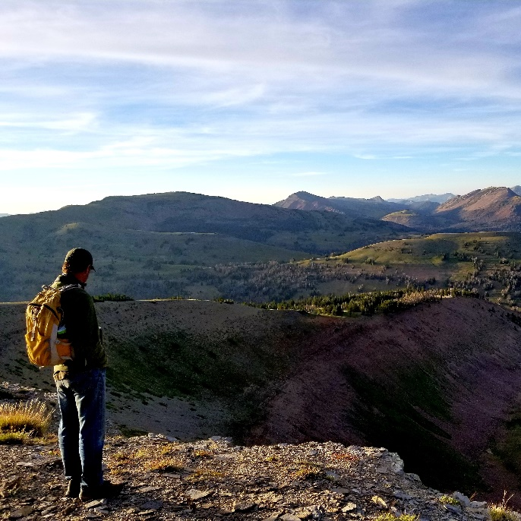
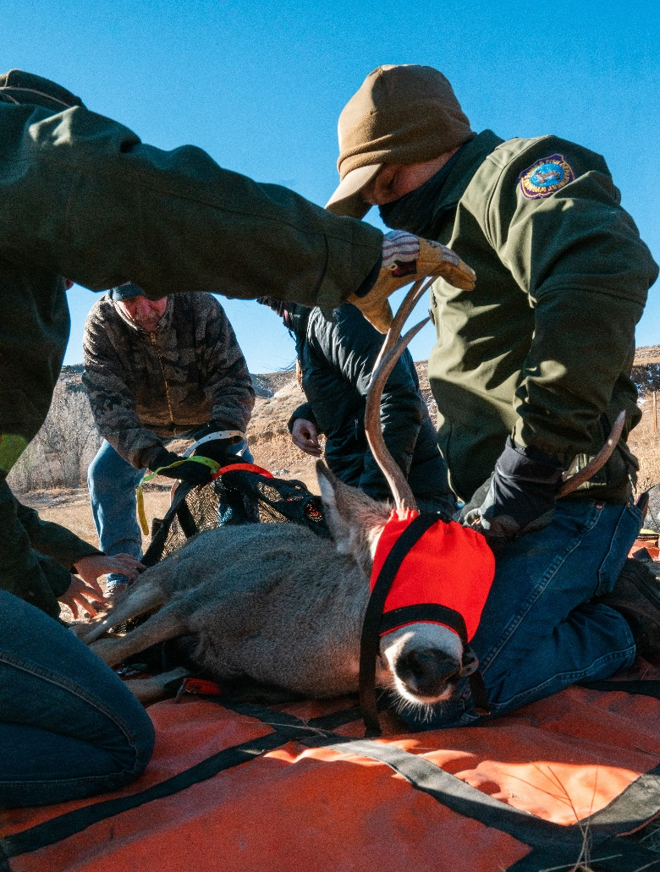
12 months
ALREADY LEARNING
NEW THINGS
Dashboard

Slide 7
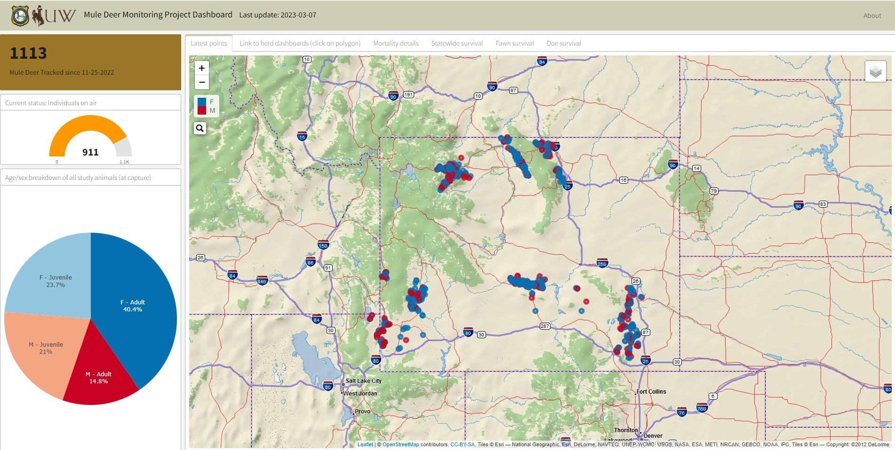
Deer tracked since 11.25
Capture composition

Slide 8
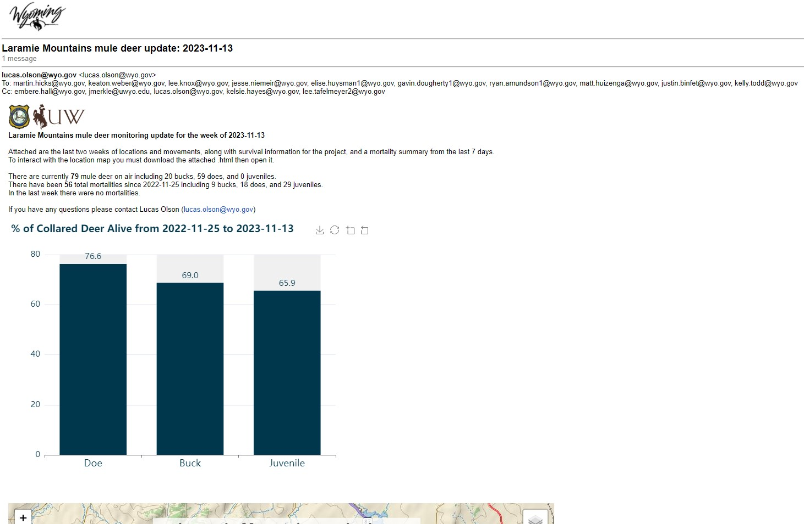

Slide 9
62% does 77-80%, wr 31%
64% bucks* 64-90%, wr 26%
42% juveniles 63%, sw 34%, wr 0%
Statewide survival
Notes:
429 animals on air

Slide 10
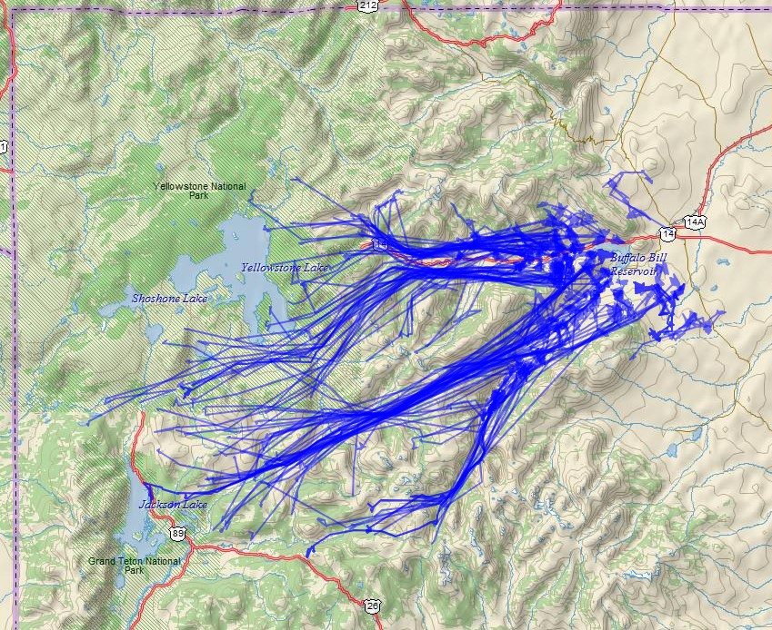

Slide 11
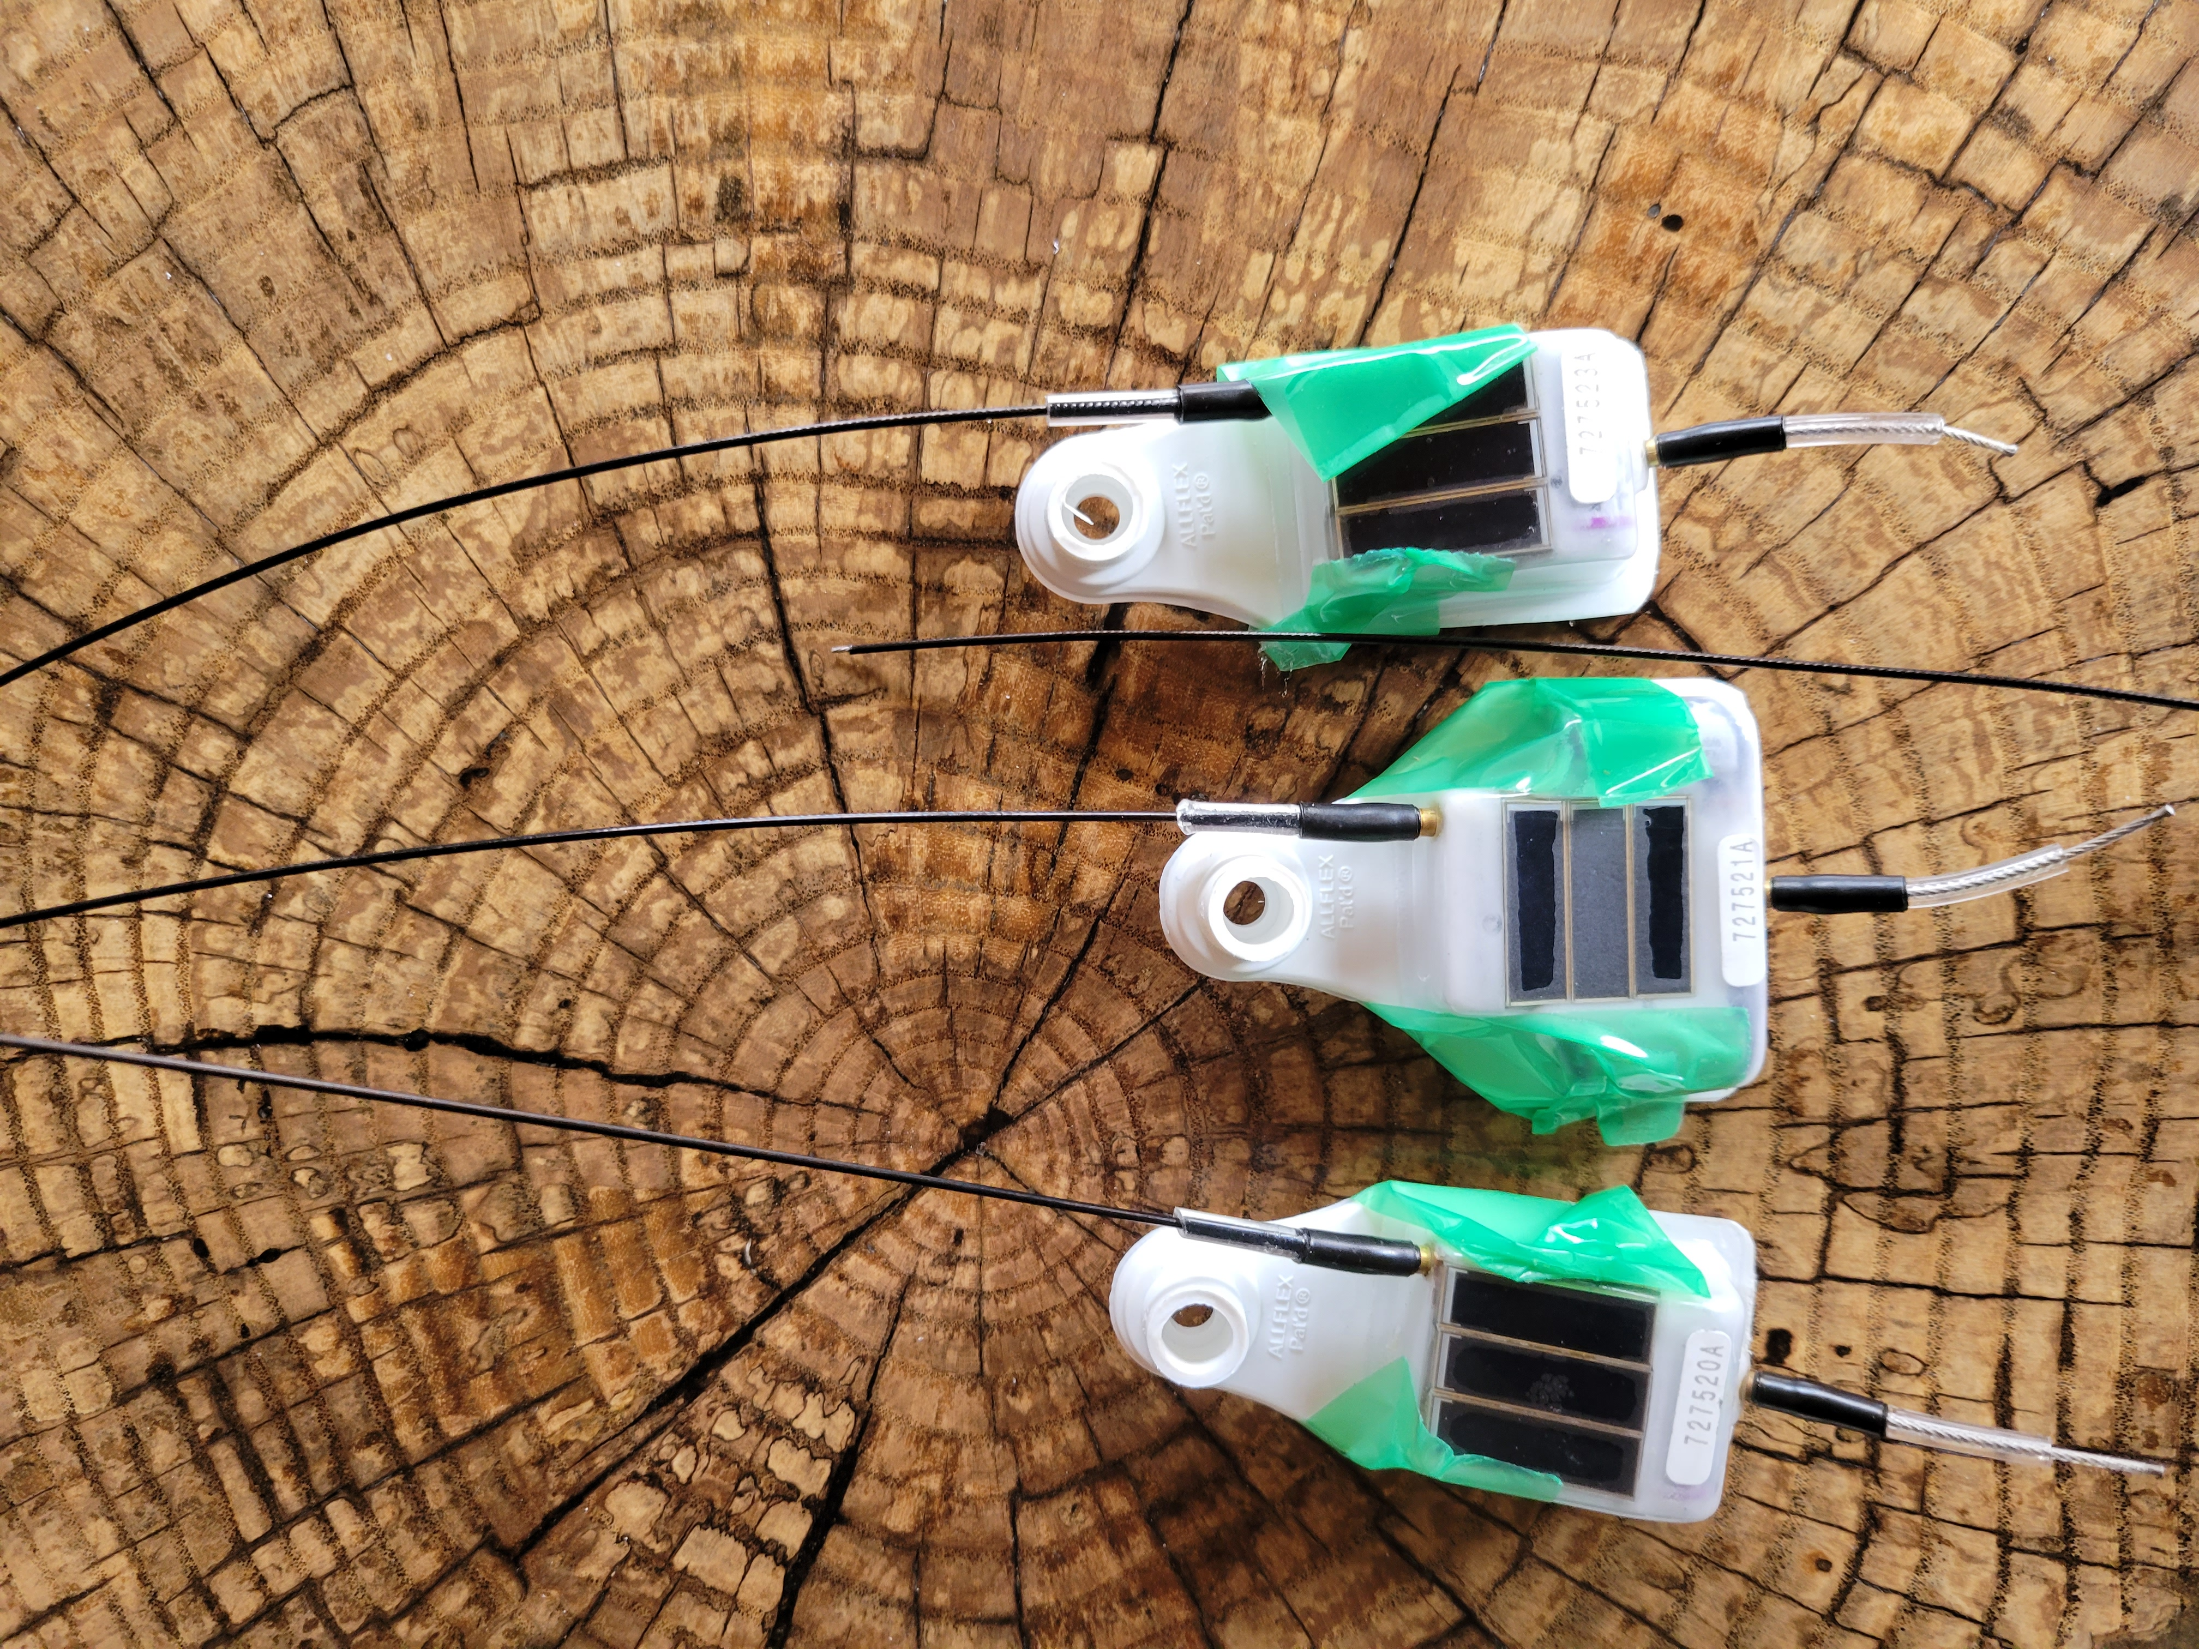
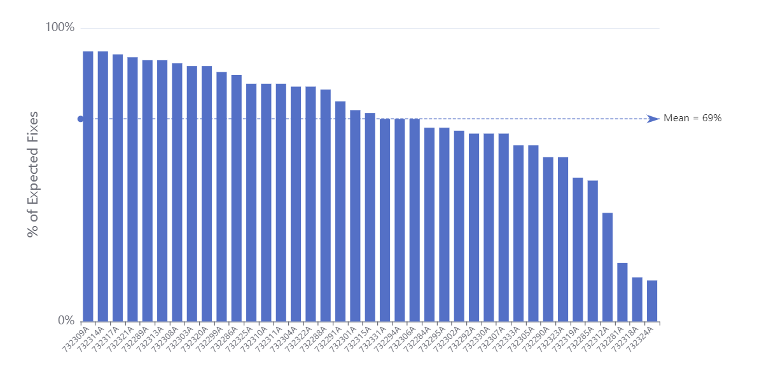
SOLAR EAR TAGS
% of expected fixes
(this gray box is image/photo placeholder)
4x6
69%
Deployed 40 units (20 on adults, paired with GPS collars; 20 on juveniles)
(this gray box is image/photo placeholder)
Mean distance between paired points 18.7 m

Slide 12
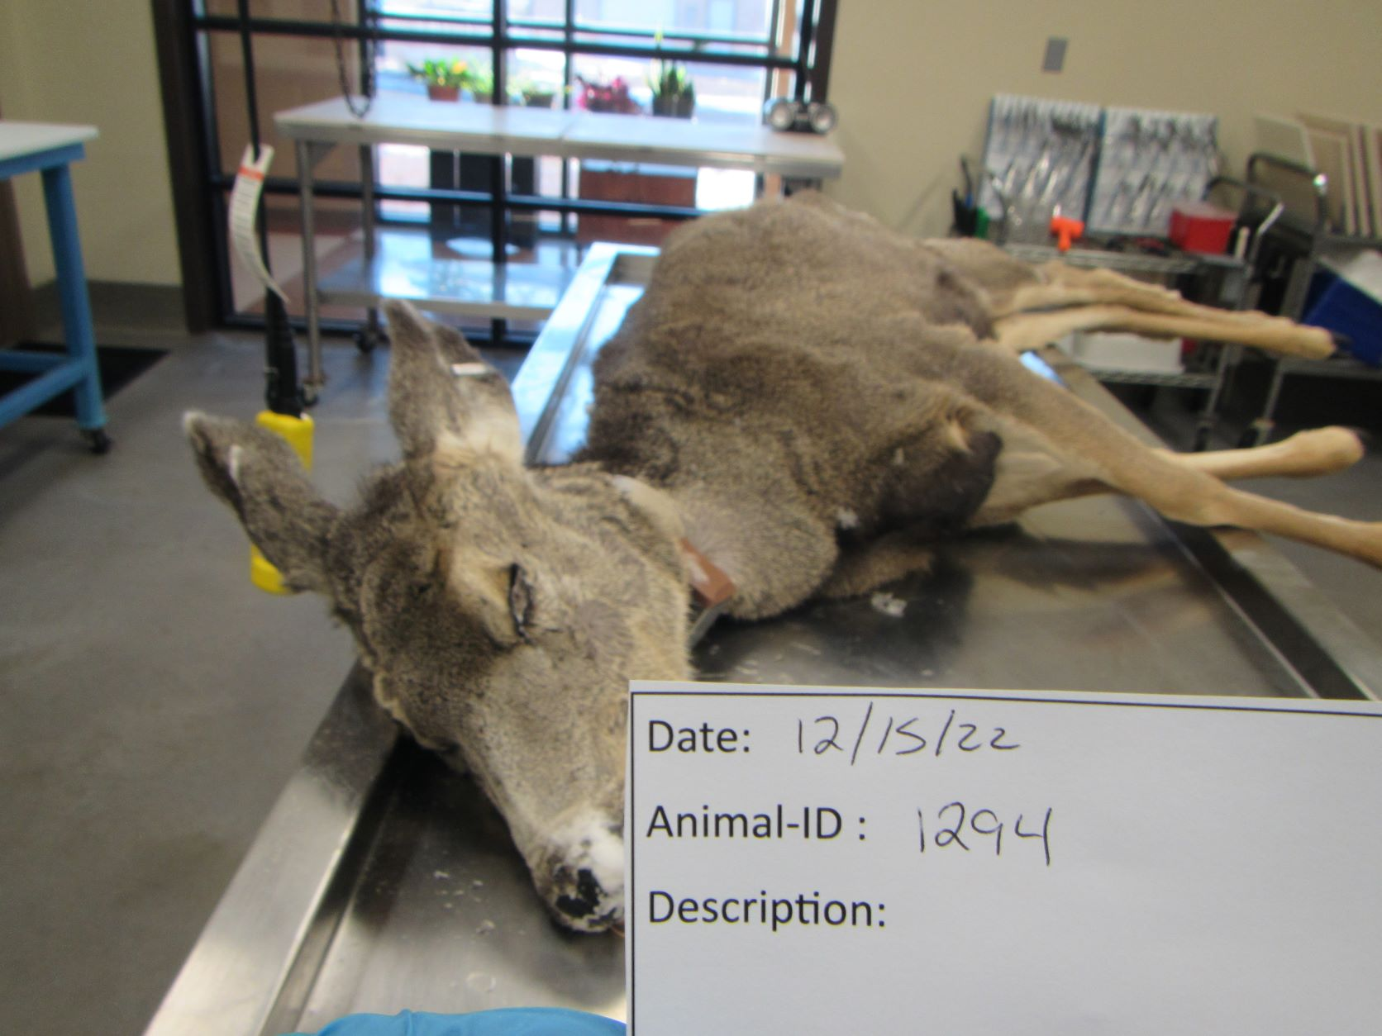
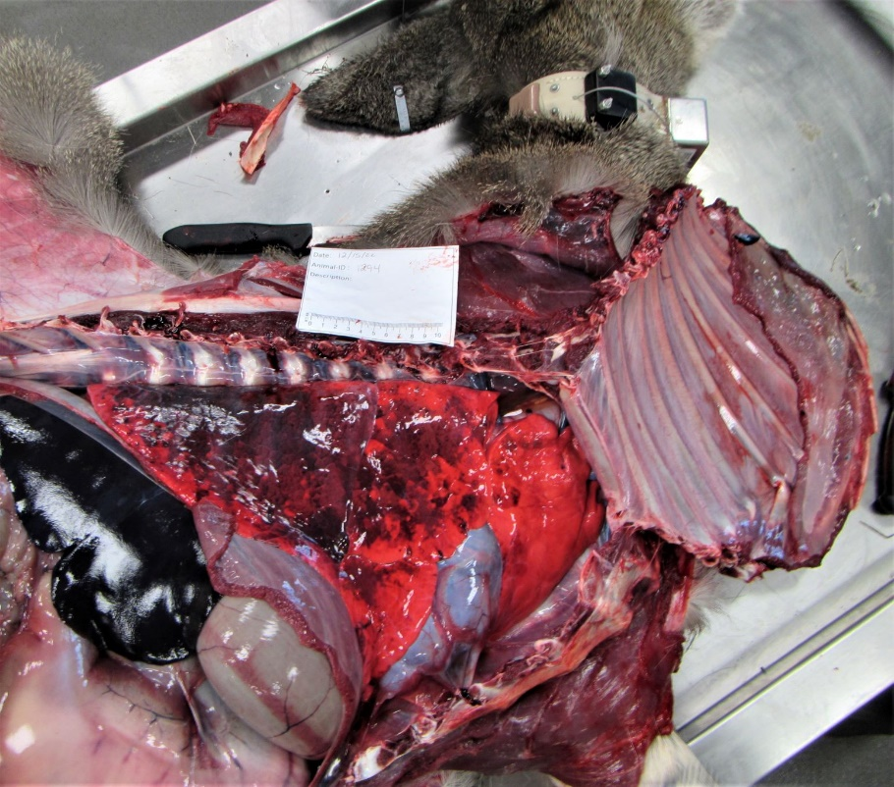
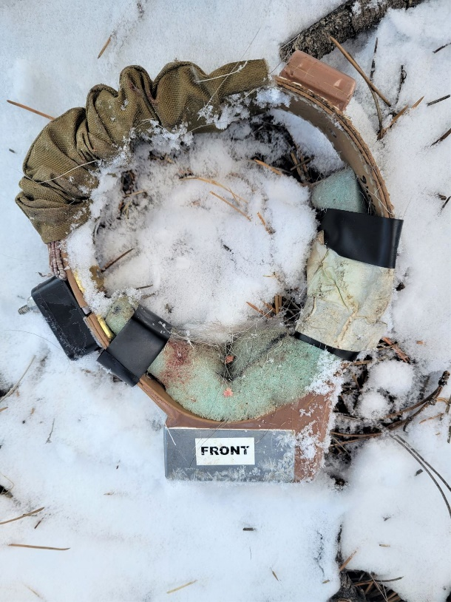
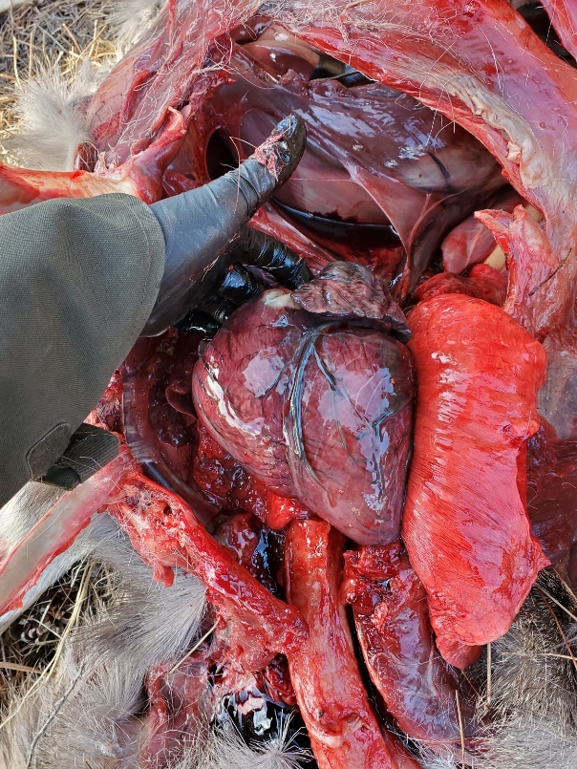
Predator Component
Cause-specific mortality
2 herds - Laramie Mountains & Sweetwater
Cutting edge pathology and field necropsy protocols
Technician support
48 animals trimmed in – results forthcoming
Notes:
CWD results

Slide 13
2023-24 CAPTURES Nov 27 – Feb 15
Herd | Does | Bucks | Juveniles
Laramie Mountains | 17 | 4 | 100
Wyoming Range | 56 | 21 | 100
Sweetwater | 17 | 11 | 100
North Bighorn | 17 | 6 | 100
Upper Shoshone | 16 | 3 | 100
Biological samples: Juvenile weights, adult blood + feces
Technology: 40 solar tags (20 paired, 20 unpaired)
Notes:
Region meetings complete
Collars ordered (changes to sizing)

Slide 14
Questions
Embere Hall
Science, Research, and Analytical Support Unit
Supervisor
embere.hall@wyo.gov
Notes:
Can include image as a background, if desired.

